Slide 1
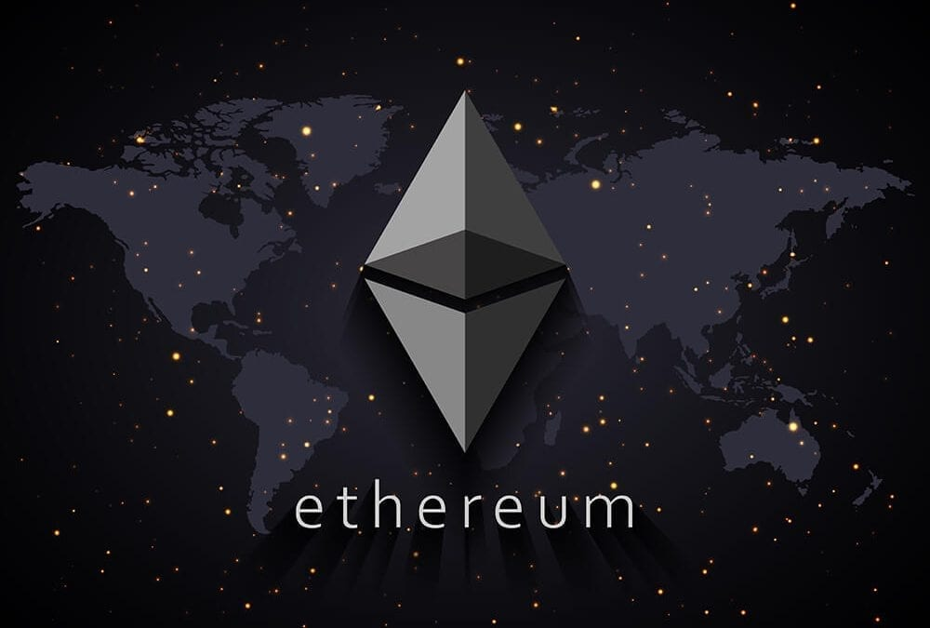
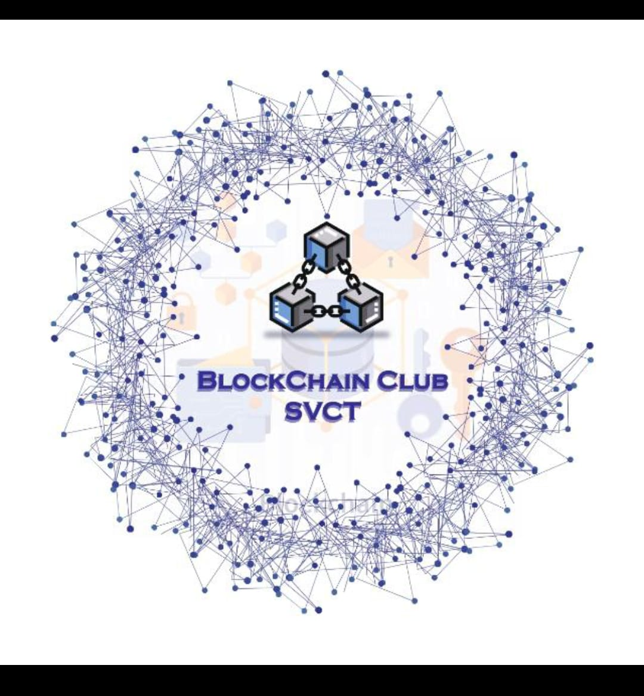

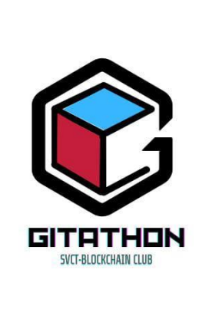
ETHEREUM BLOCKCHAIN AND SMART CONTRACTS
CREATED BY:
KATAM ANUSHA RANI
B.TECH AI&DS

Slide 2

TOPICS INCLUDED:
1.INTRODUCTION
2.UNDERSTANDING BLOCKCHAIN
3.THE ETHEREUM ECOSYSTEM
4.SMART CONTRACTS
5.ETHEREUM VIRTUAL MACHINE (EVM)
6.DECENTRALIZED APPLICATIONS (DAPPS)
7.ETHEREUM GAS AND TRANSACTIONS
8. CHALLENGES AND SCALABILITY
9. USE CASES OF ETHEREUM
10.SECURITY ND AUDITING
11.FUTURE OF ETHEREUM
12.CONCLUSION

Slide 3
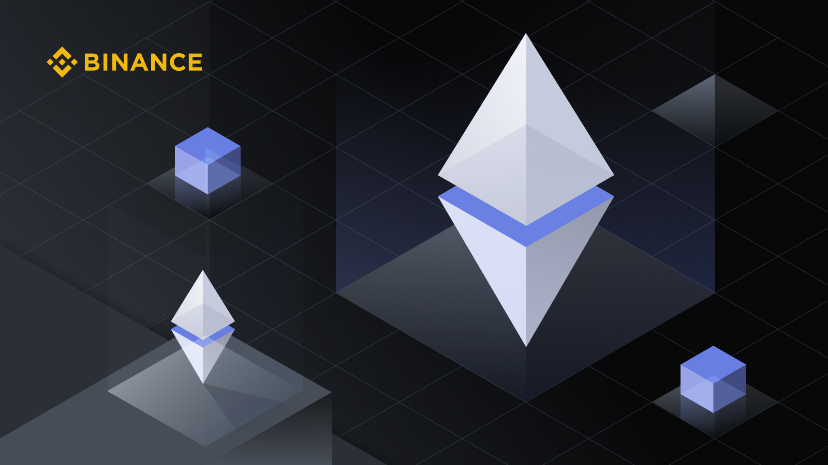
INTRODUCTION:
Ethereum is a decentralized blockchain and development
Platform. It allows developersto build and deploy applicatons
And smart contracts
Ethereum enables building and deploying smart contracts
And decentralized applications (dAPPS) without downtime,
Fraud,control or,interference from a third party

Slide 4

Understanding Block chain:
.Block chain is a dencentralized, immutable ledg that
Records transactions act a network of computers. It
Securtity and transparency by utilizing cryptographic
techniques
. Block chain Technology is advanced database mechanism
That allows transparent information sharing within a
Businesss network…

Slide 5
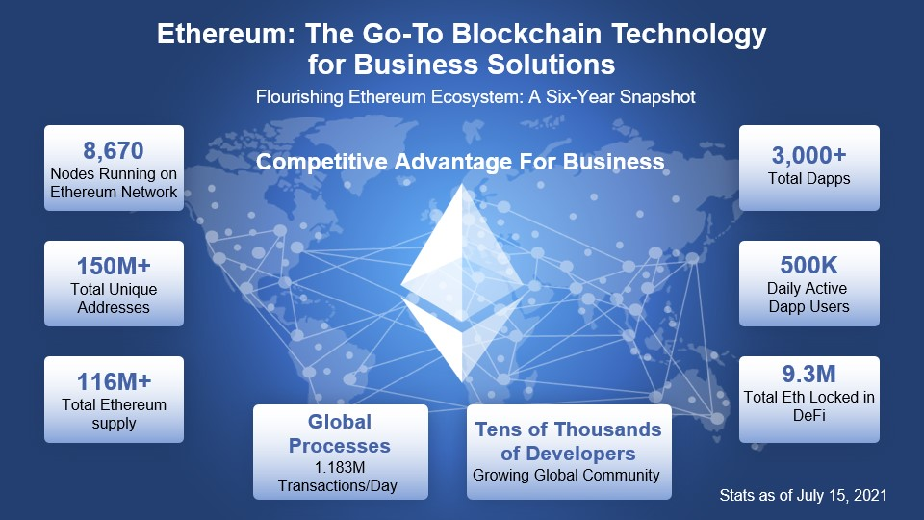

Slide 6
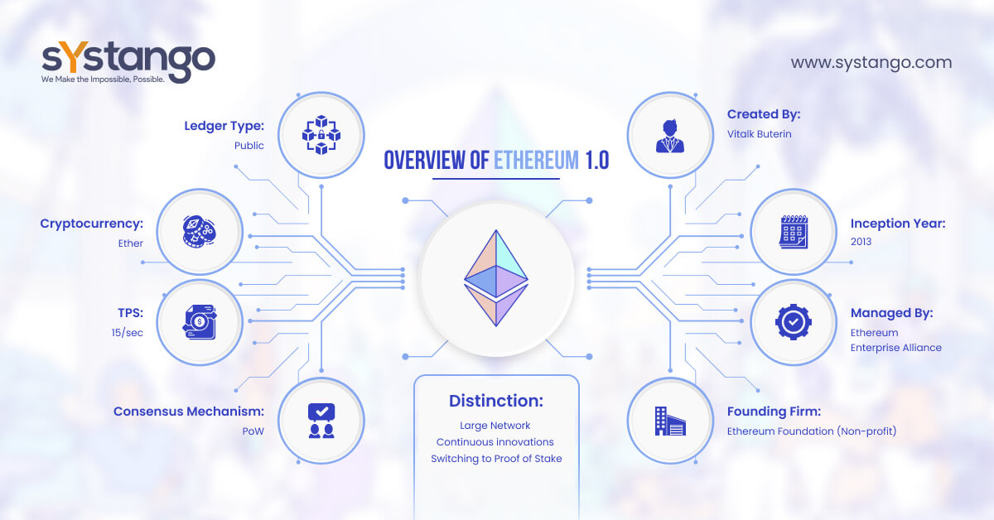

Slide 7
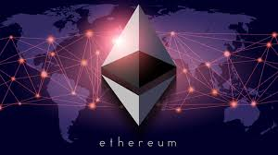
The Ethereum Ecosystem:
Etherum is a decentralized platform that enables the creation of smart contracts and decentralized applications (dAPPS) . Its native cryptocurrency is native cryptocurrency is called Ether.

Slide 8
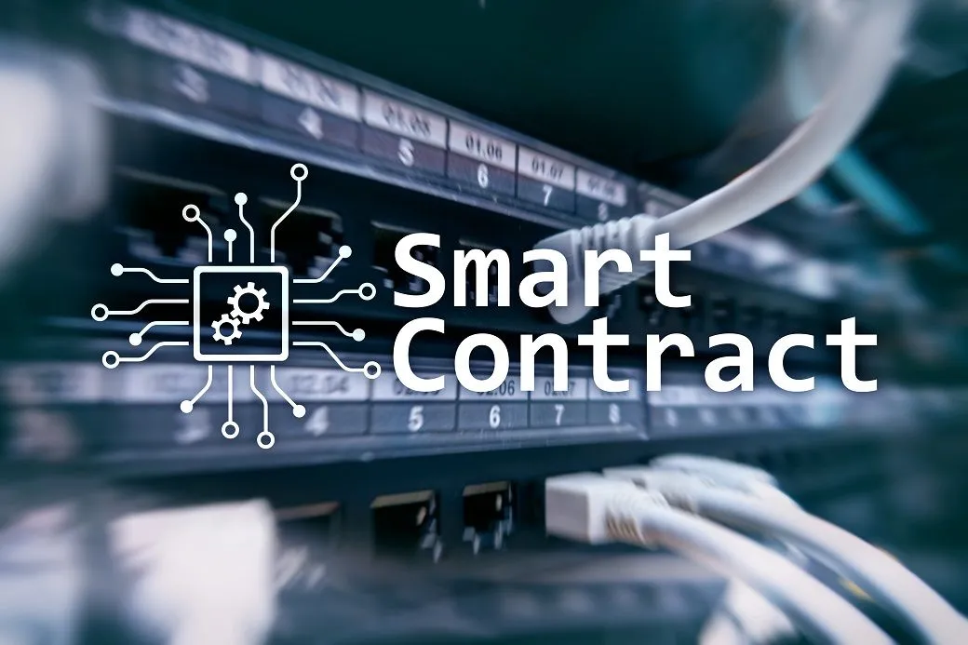
SMART CONTRACTS:
smart contract are self executing contracts with the trems of the agreements directly written into code .
They automatically enforced and execute the terms of an agreement

Slide 9
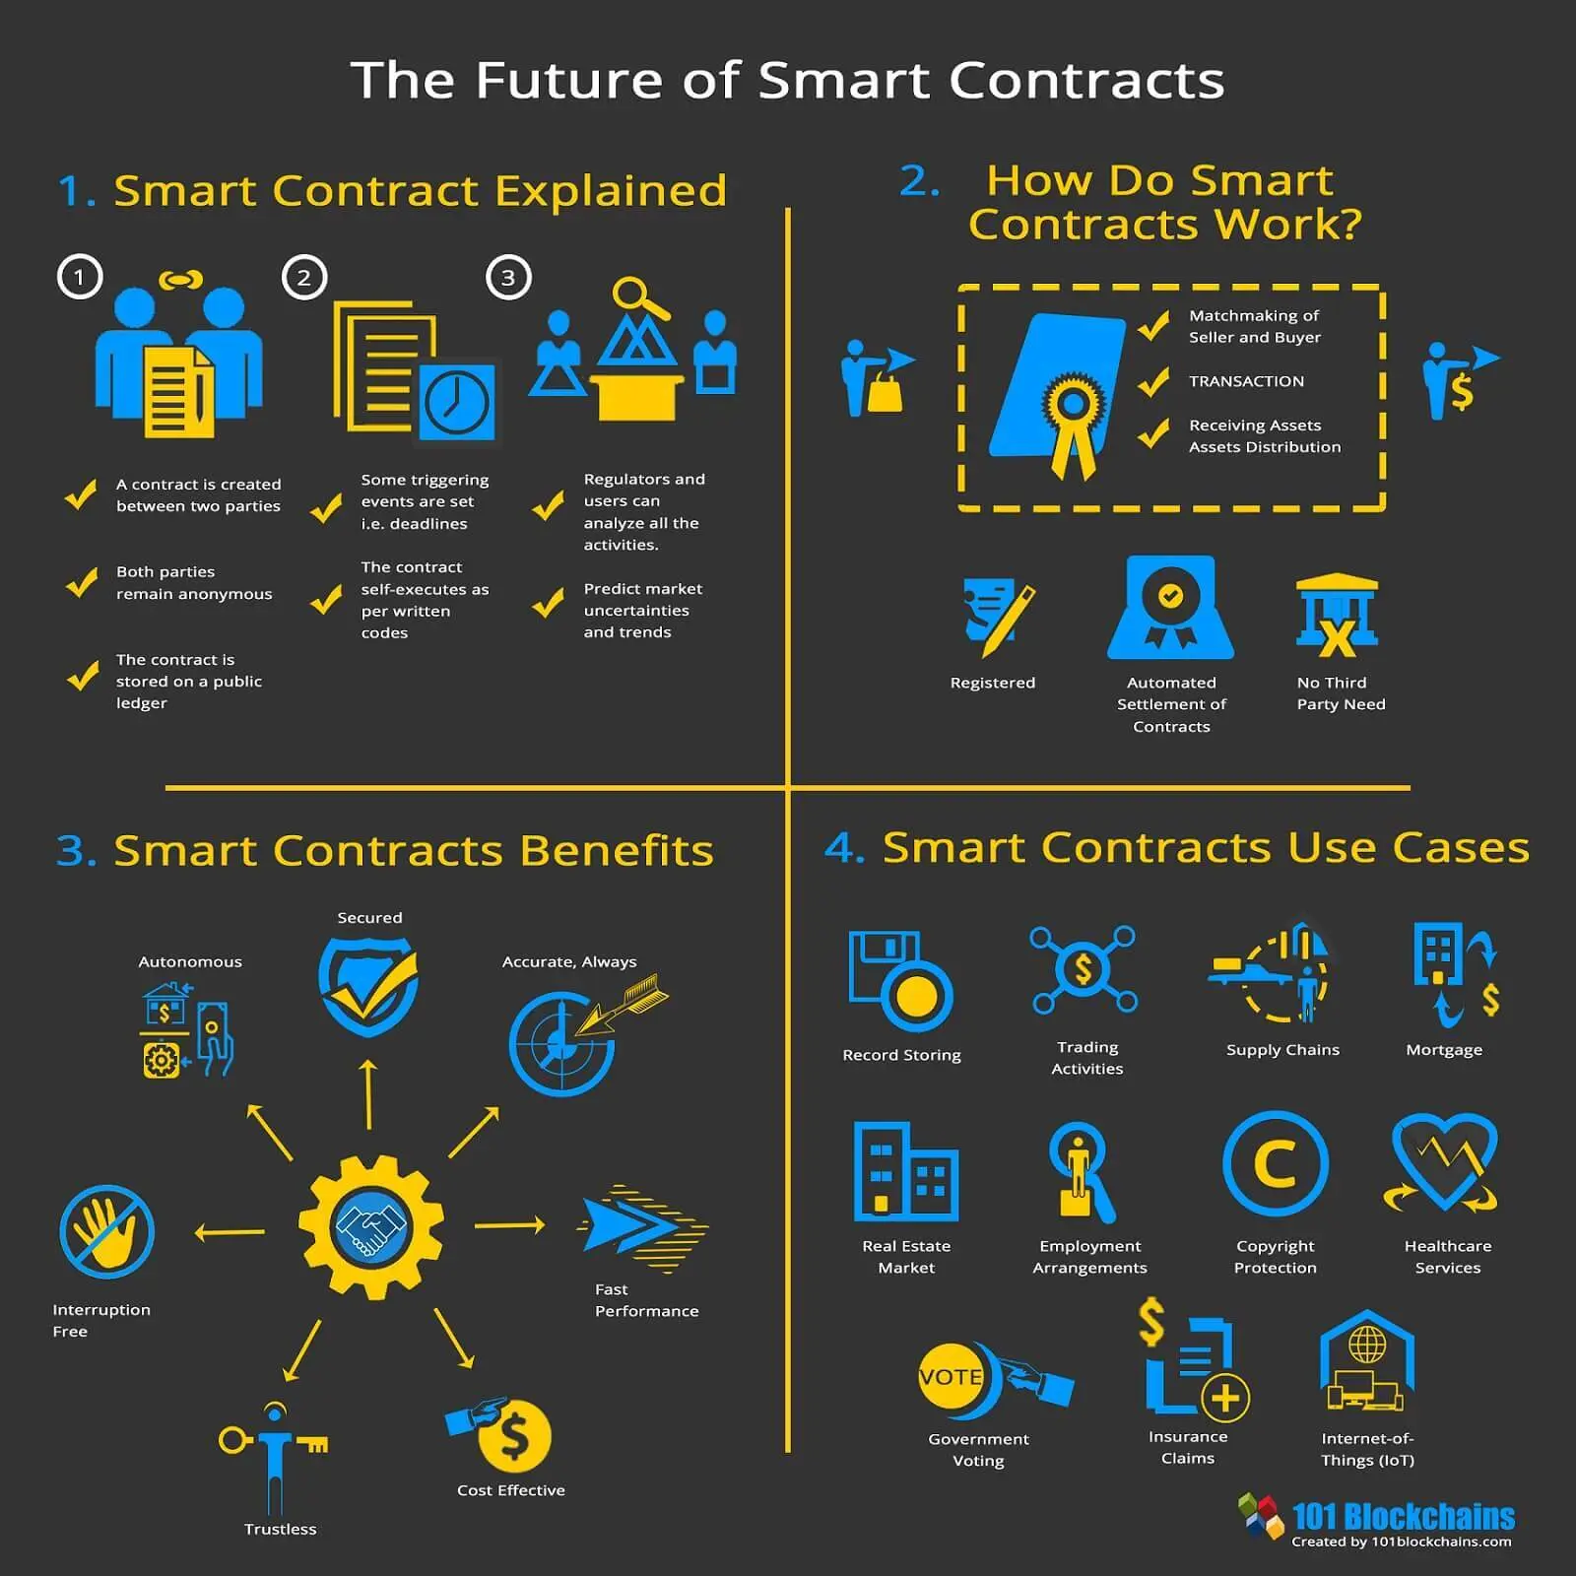

Slide 10
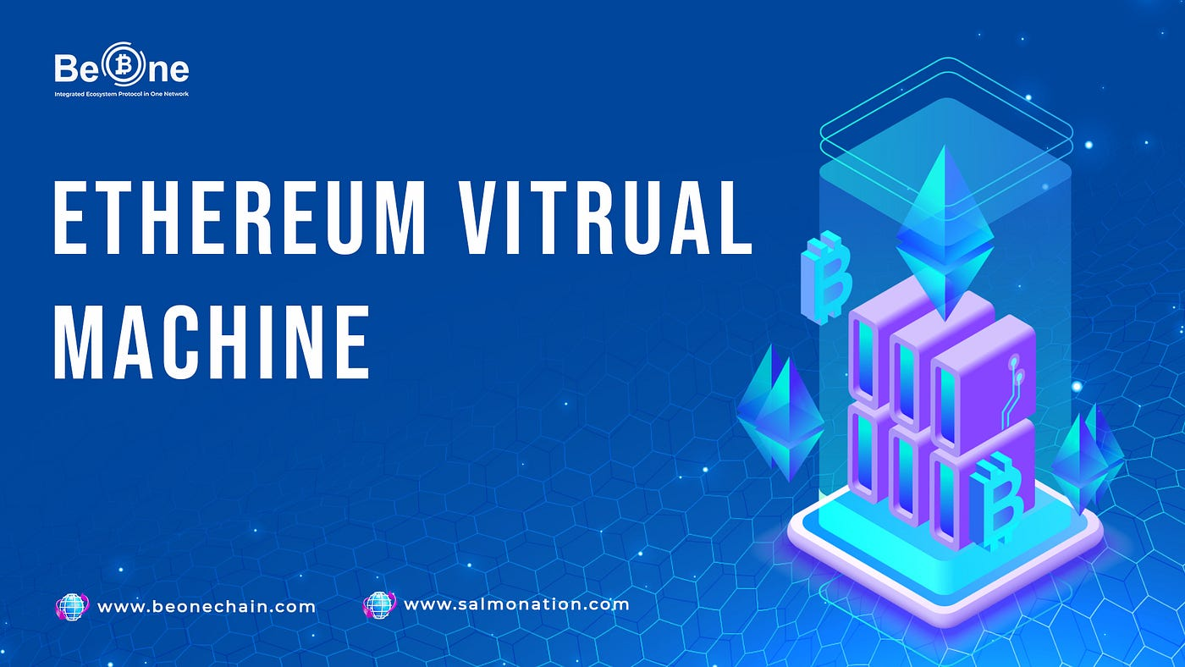
ETHEREUM VIRTUAL MACHINE (EVM):
The Ethereeum virtual
Machine is the runtime environment for smart
Contracts in Ethereum. It enables the execution of smart contract code in a secure and deterministic manner.

Slide 11
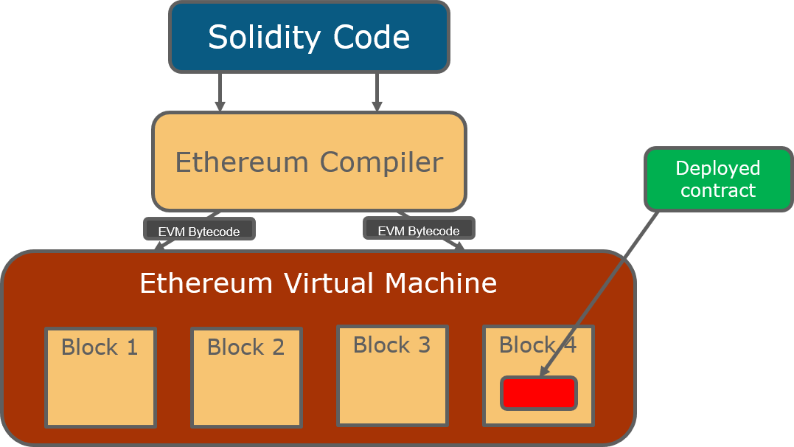

Slide 12
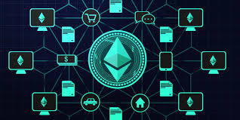
Decentralized Apps(dApps)

Slide 13

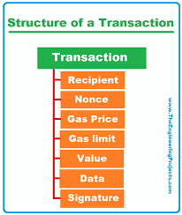

Slide 14
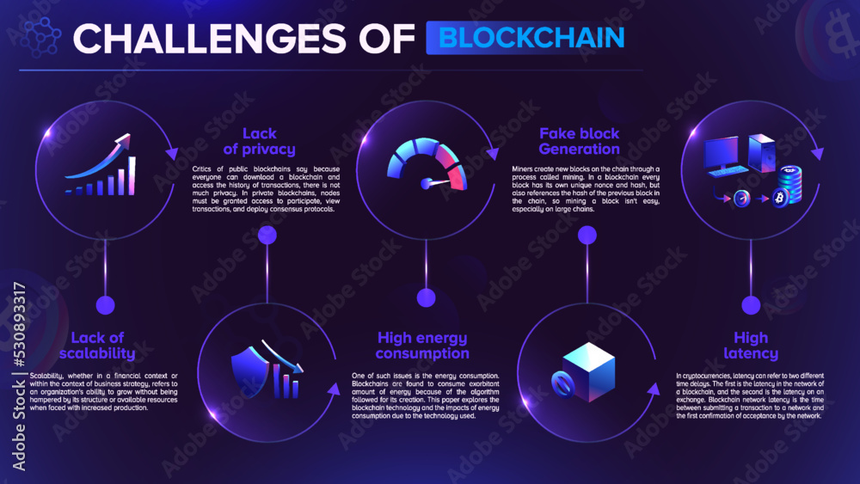

Slide 15

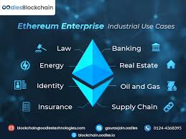
USE CASES IN ETHEREUM:

Slide 16
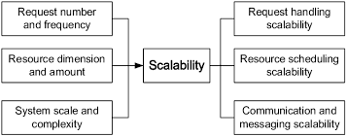
CHALLENGES AND SCALABILITY

Slide 17
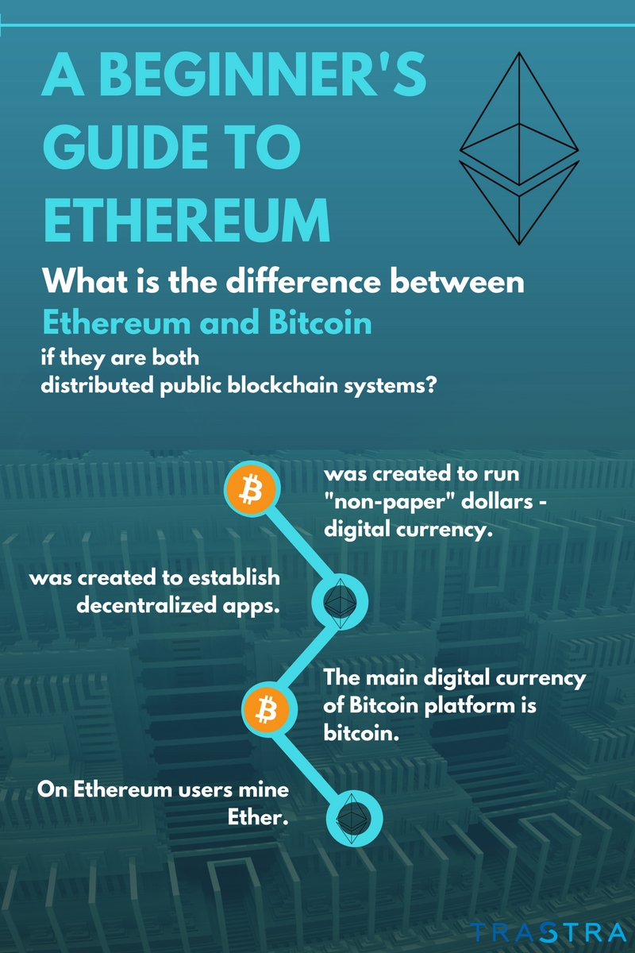
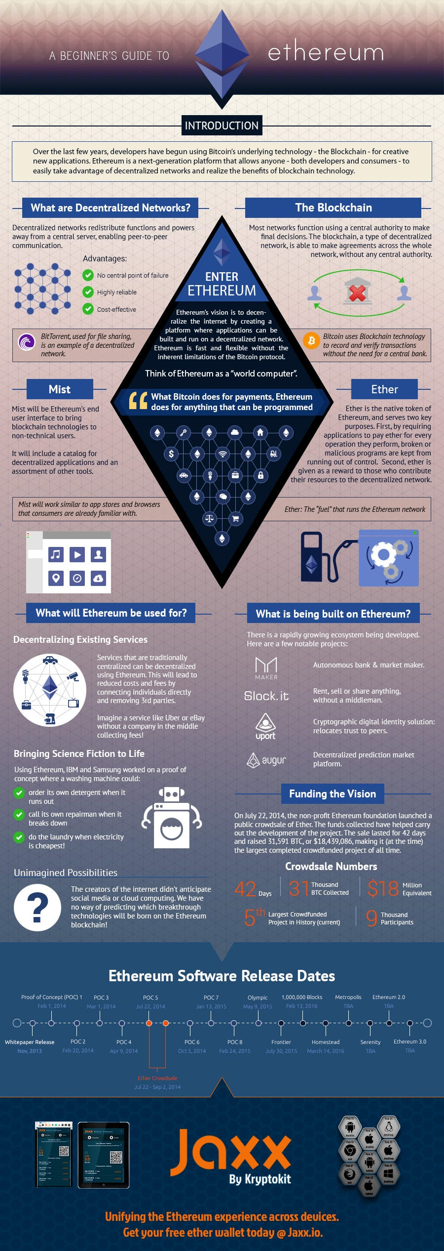

Slide 18
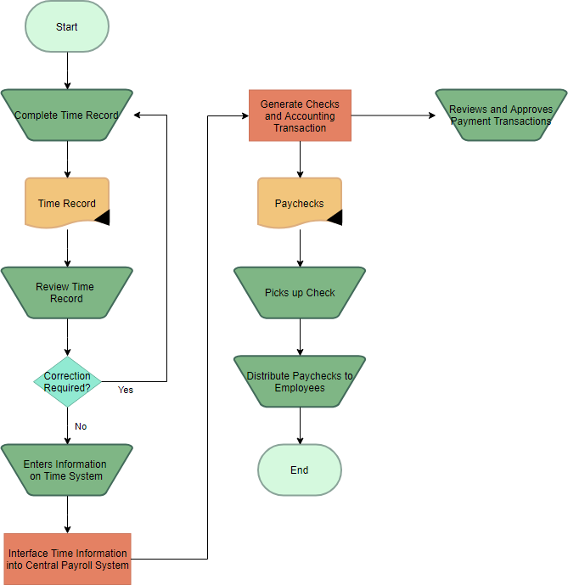


Slide 19
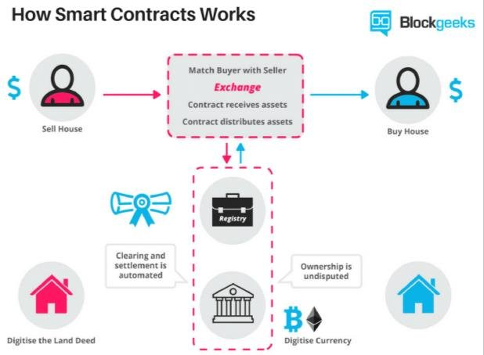

Slide 21
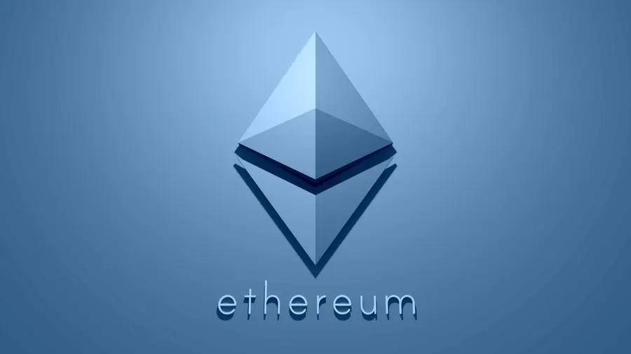
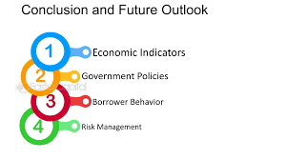
CONCLUSION:
In conclusion , Ethereum has redefined the landscape of blockchain technology with its innovative approach to smart contracts and decebtralize applications.
Its impact will continue to shape the future of various industries….

Slide 22
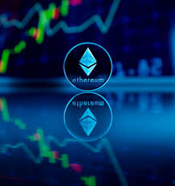
THANK YOU ALL!!!!!!!!!
DESIGNED BY:
KATAM ANUSHA RANI
AI&DS

